Slide 1


Data Engineering
PROJECT

Slide 2

Data Source
One of the most popular social media platform in terms of daily active users.
Unique infrastructure where any user can follow any other users.
Complete data available to developers through its APIs
Free access with a Twitter account

Slide 3
Tweepy
Python Library used to connect to Twitter Streaming API and to download the data.
Require Twitter API credentials generated by Twitter when creating the app.

Slide 4
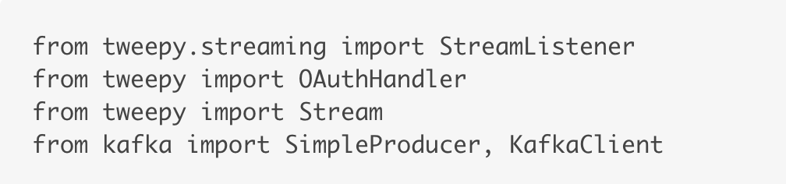
Storing Twitter data in db with the help of Kafka
Start Zookeeper and Kafka servers in the local machine
Create python program to access the data from Twitter API and direct it to the Kafka topic.
Necessary methods are imported from Tweepy and Kafka Library

Slide 5
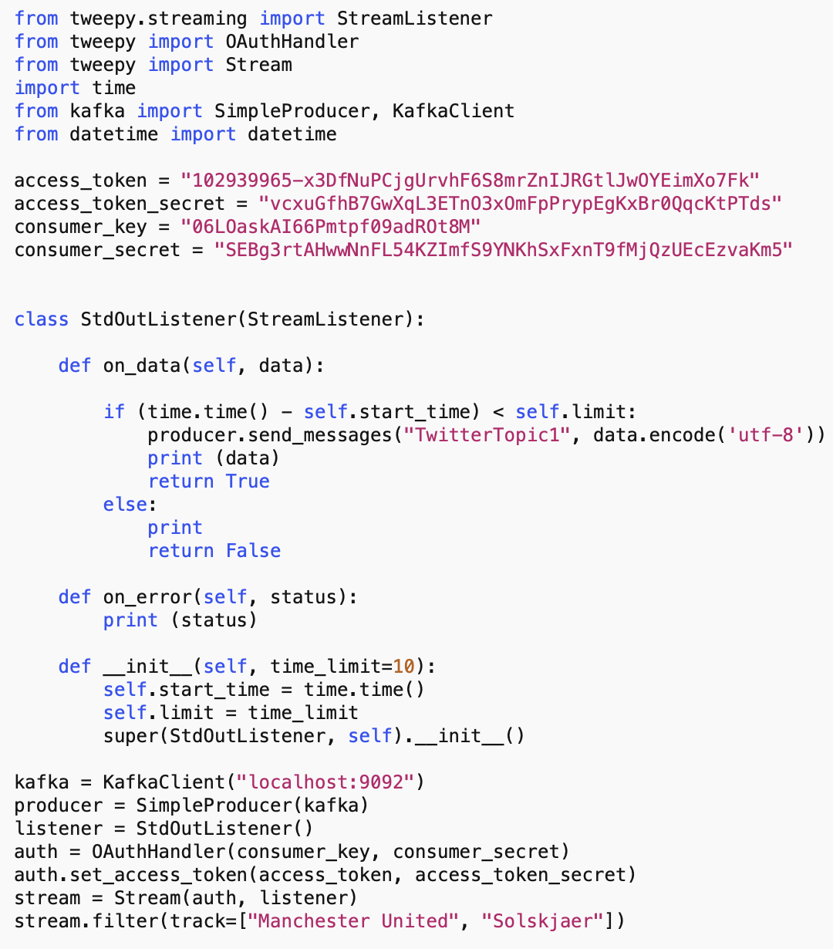
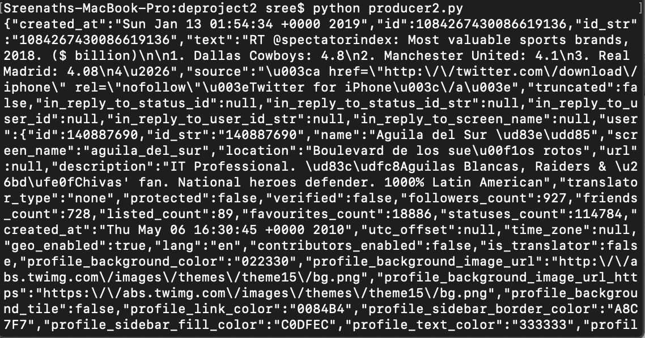
PRODUCER Script
OUTPUT
In order to store this data into db (Mongodb) we are using the consumer script.
Also this data could be captured to a text file for transferring to another pc or person for later analysis or whatsoever.
python producer2.py > producer2.text #JSON format

Slide 6
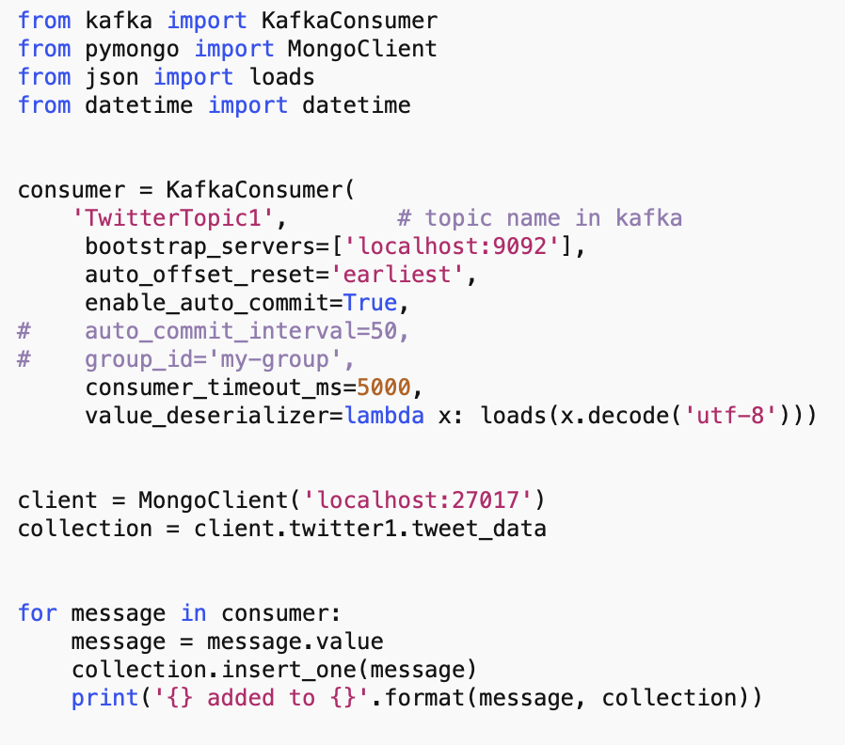
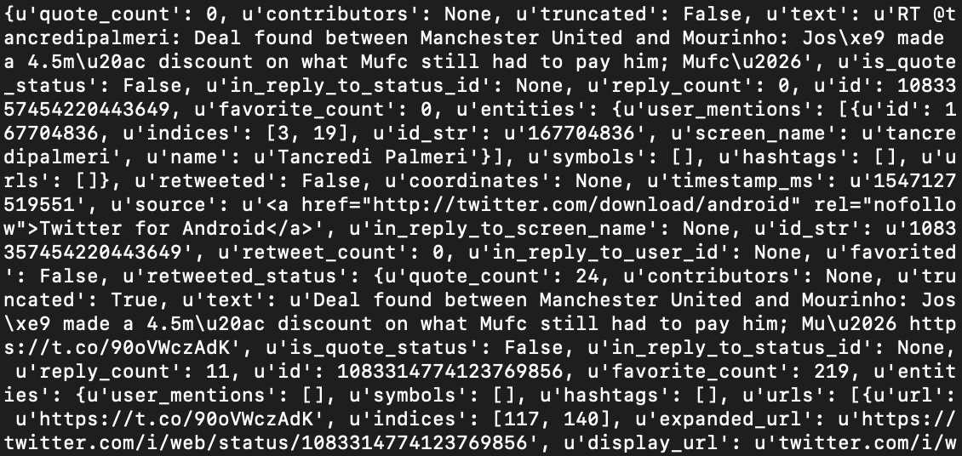
CONSUMER Script
Data being directed to Mongodb and stored in a collection
Database name: twitter1
Collection name: tweet_data
The output is printed simultaneously in the terminal

Slide 7

Data Analysis and Visualisation
Tools used:
Matplotlib library(plotting)
Pandas Python library
TextBlob(Sentiment Analysis)
MongoD Compass
Jupyter notebook

Slide 8
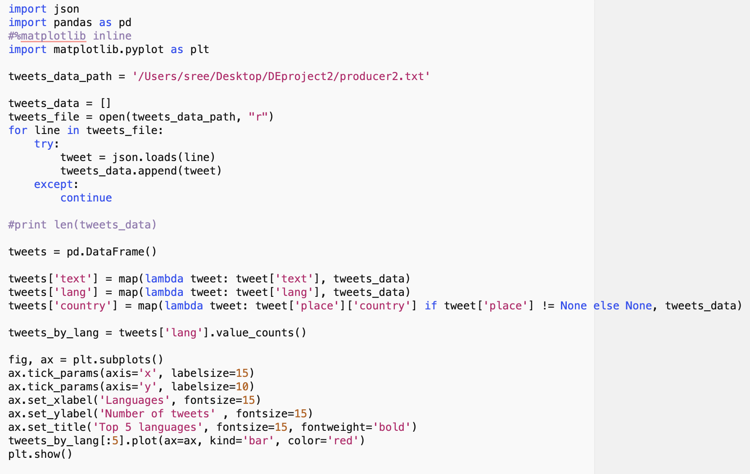
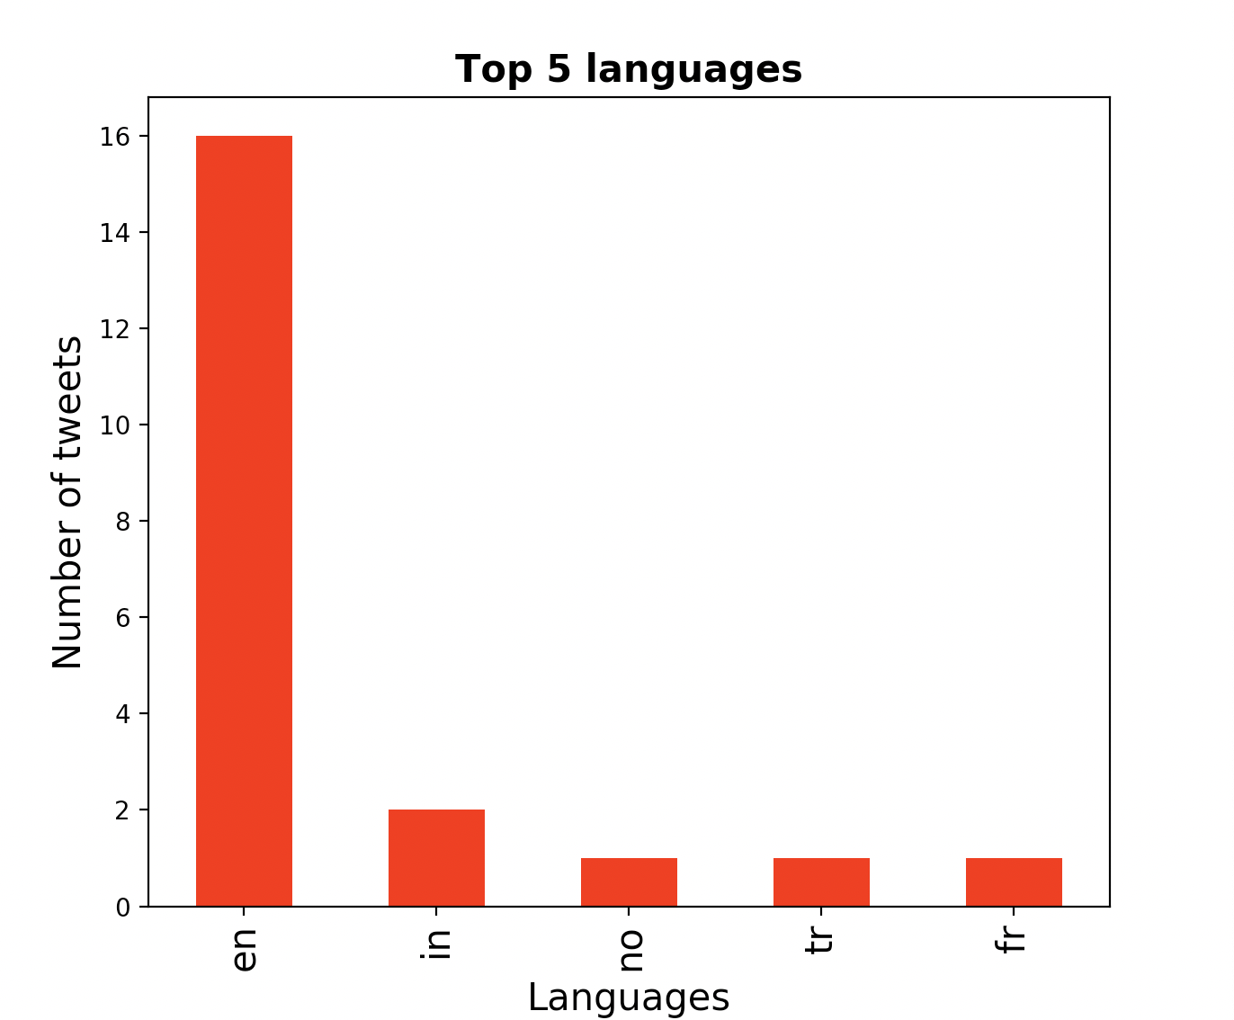
Plotting a graph based on language

Slide 9
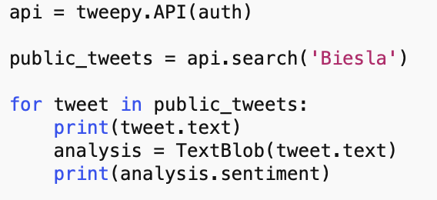
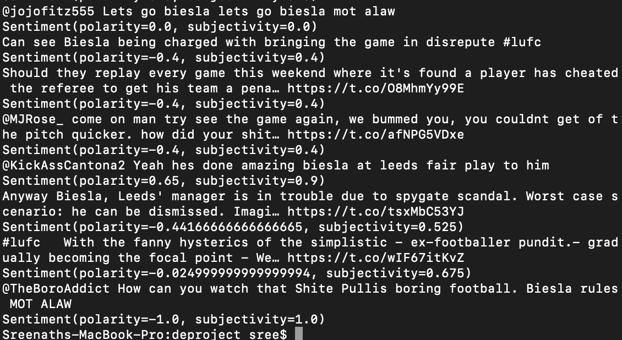
Sentiment analysis using TextBlob
TextBlob is a python library for processing textual data.
Sentiment value generated by two variables : Polarity and Subjectivity
Calculated on a scale of -1 to +1
Neutral = 0
Negative = <0
Positive = >0

Slide 10
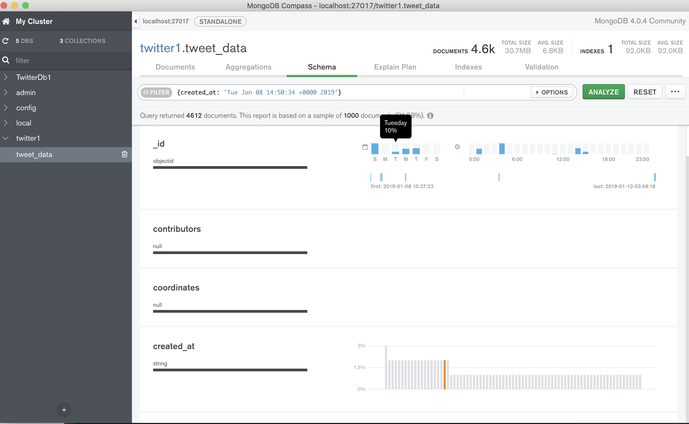
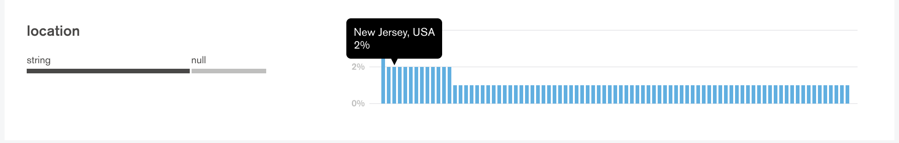
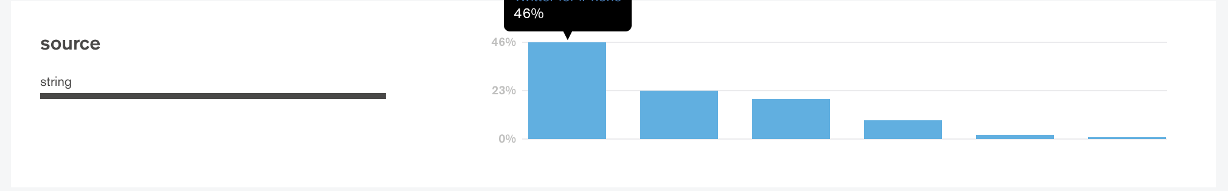
Mongod Compass

